Slide 1

ITMD 522:
Pandemic Predictions:
A COVID-19 Outcome Classification
Group 822
Gyuhwan Choi
Tsucheng Lu
Tinghan Li

Slide 2

Agenda
Introduction
Data preprocessing
Data Analysis
Modeling
Conclusion

Slide 3

Introduction

Slide 4


Introduction
Background of COVID:
COVID-19 is an unparalleled global health crisis.
Over one million in the United States (CDC, 2023).
People face a significant risk of contracting the virus, with severe consequences.
Understanding the virus's dynamics is crucial for patient preparation.

Slide 5
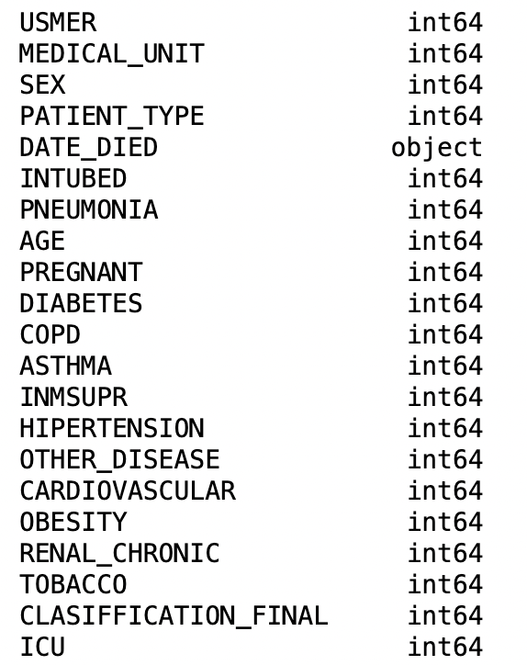
Presentation of dataset
21 columns
Mostly for the binary features, 1 = "yes" & 2 = "no".
97, 98, and 99 are missing data.
1,000K rows
Containing the information for each unique patient.

Slide 6



Objectives
ANALYZING DATA TO GLEAN INSIGHTFUL PERSPECTIVES.
BUILDING A MODEL TO PREDICT THE PATIENT IS AT HIGH RISK OR NOT.
IDENTIFYING THE MAJOR FACTORS LEADING PEOPLE INTO HIGH RISK.
Notes:
Given a Covid-19 patient's current symptom, status, and medical history, will predict whether the patient is in high risk or not.

Slide 7
Preprocessing

Slide 8
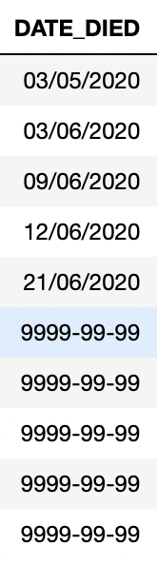
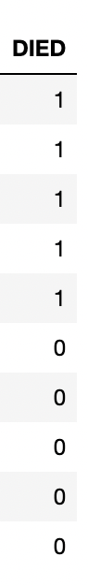
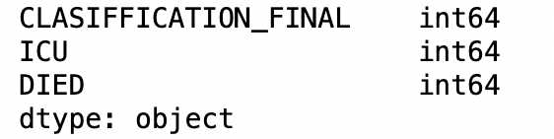
Data Preprocessing
Changing DATE_DIE into DIED.
Now it is a numerical feature.

Slide 9
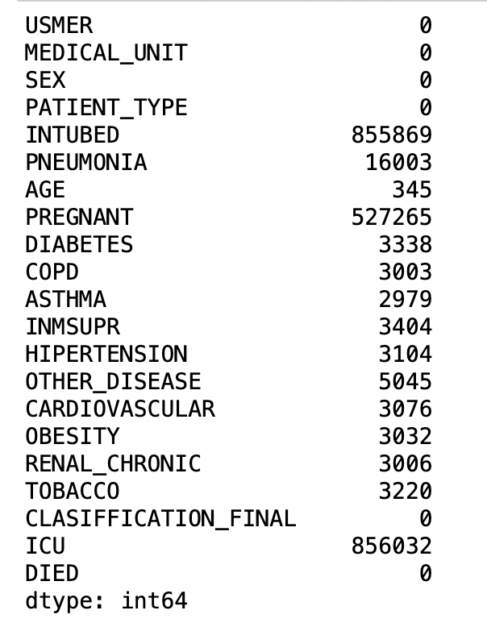
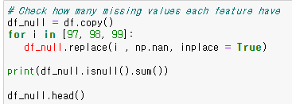
Data Preprocessing
Checking missing values:
“INTUBED”
“PREGNANT”
“ICU”

Slide 10
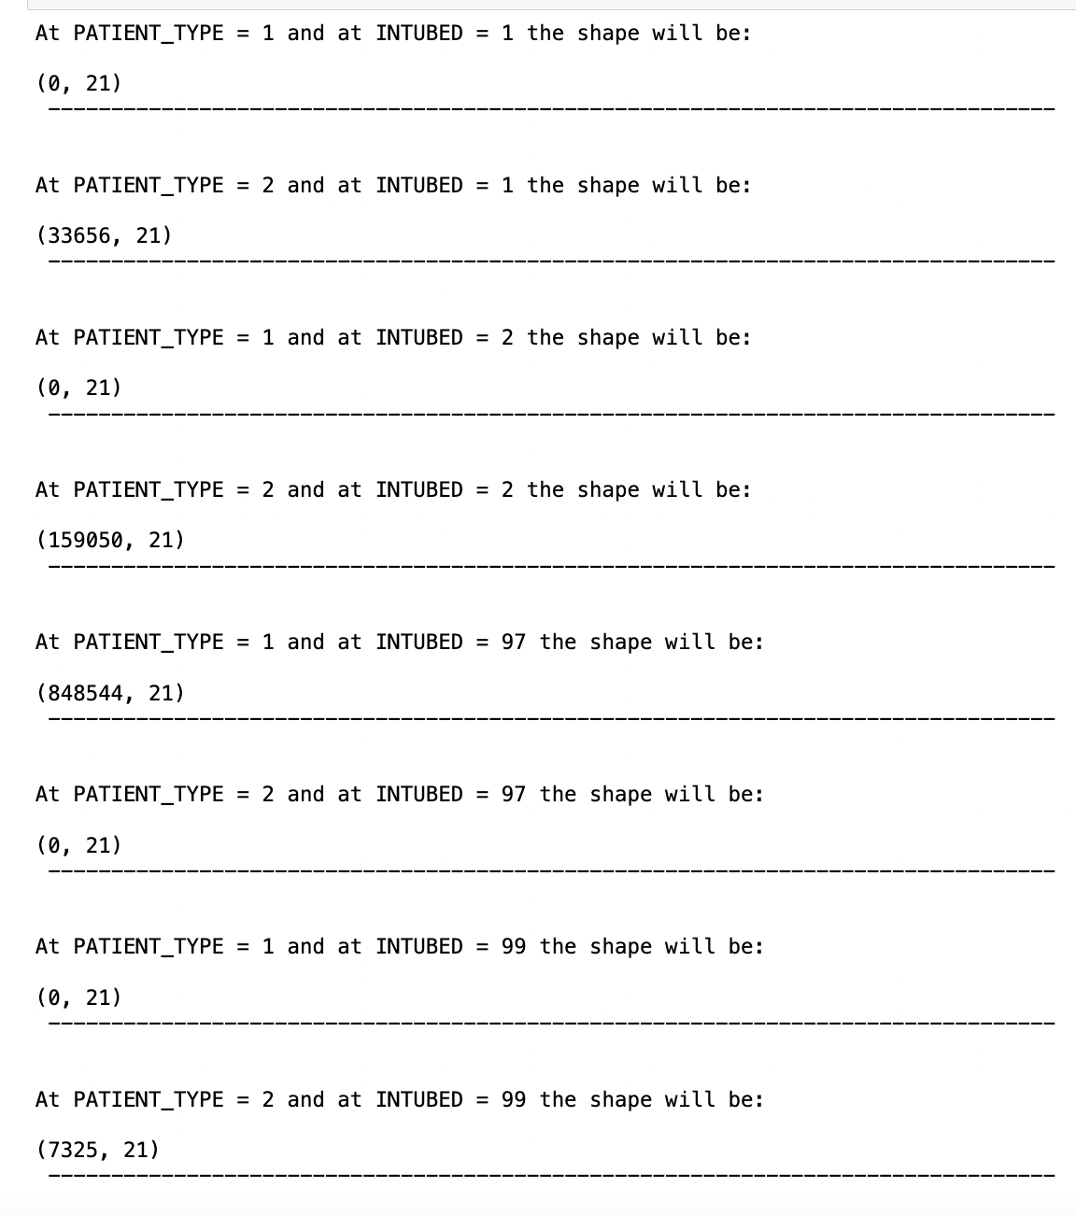
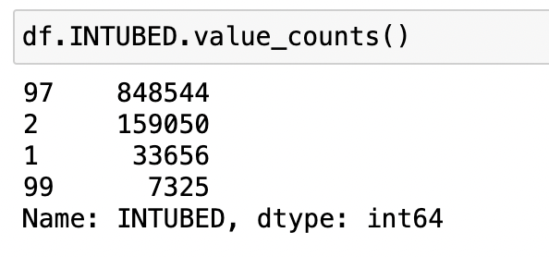
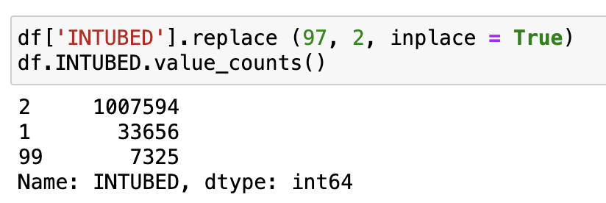
Data Preprocessing - INTUBED
The missing values of (97) are all corresponding with (2)
Patients who have never been hospitalized couldn't possibly be connected to the ventilator.

Slide 11
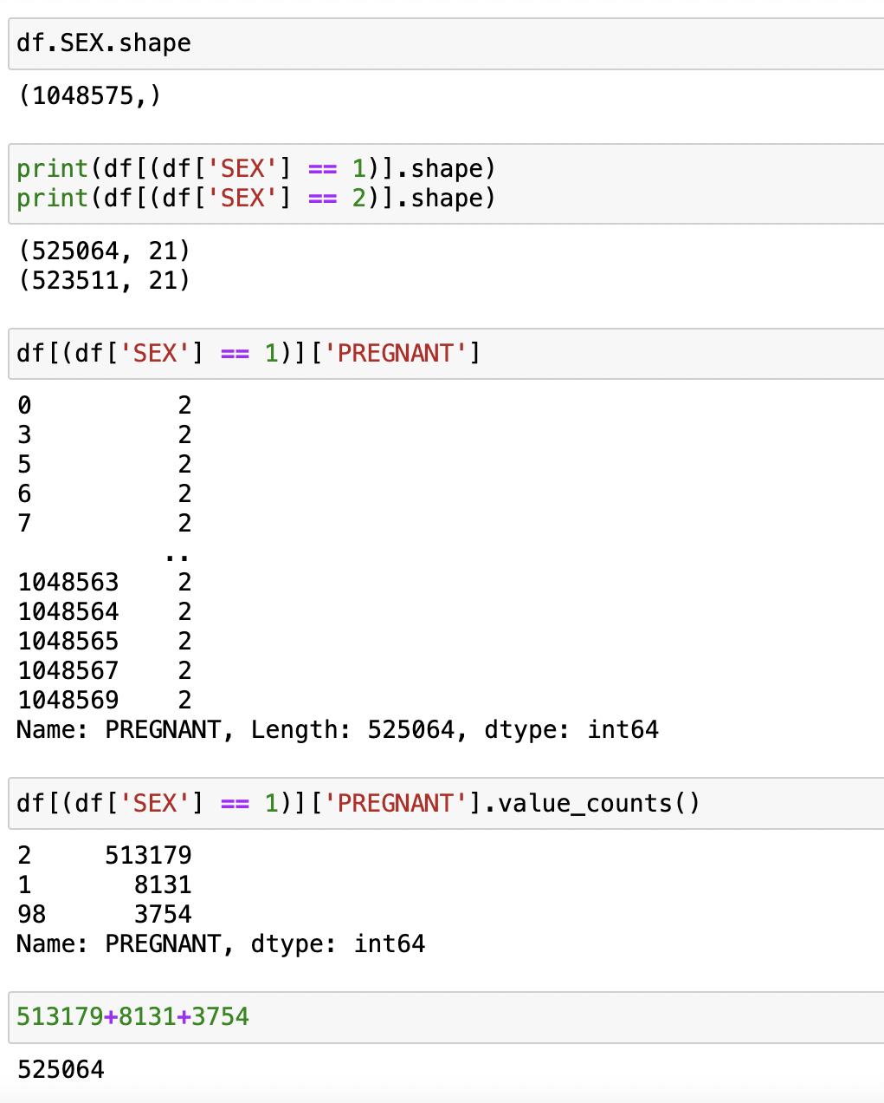
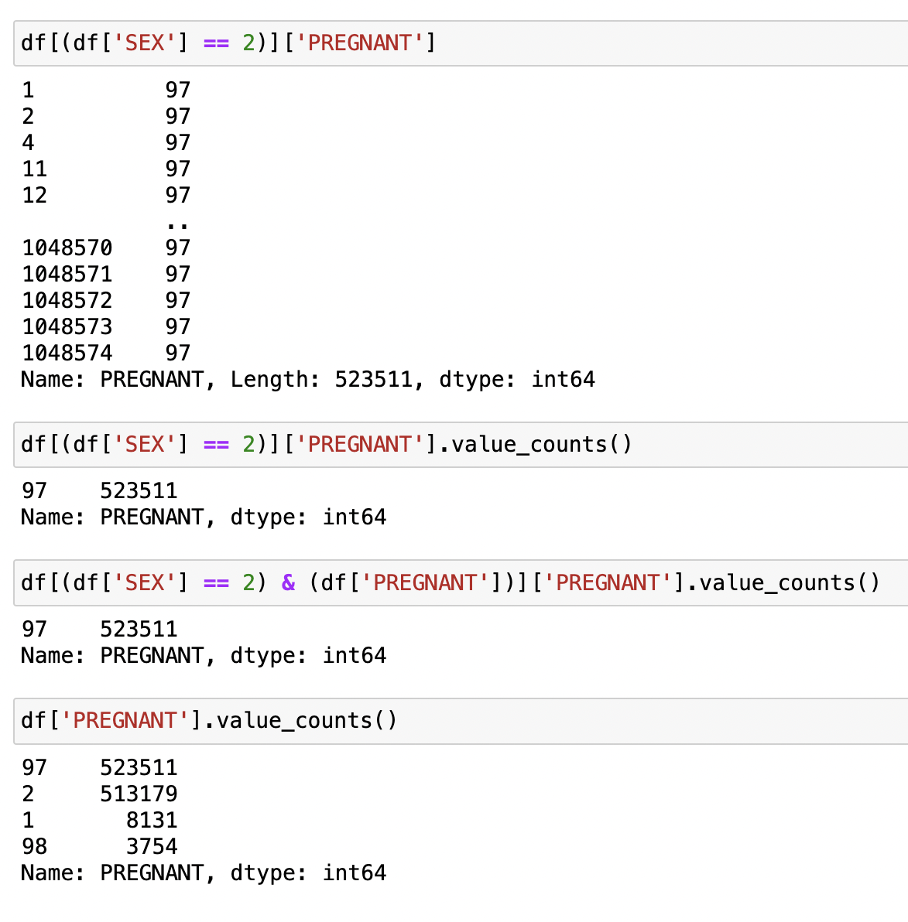
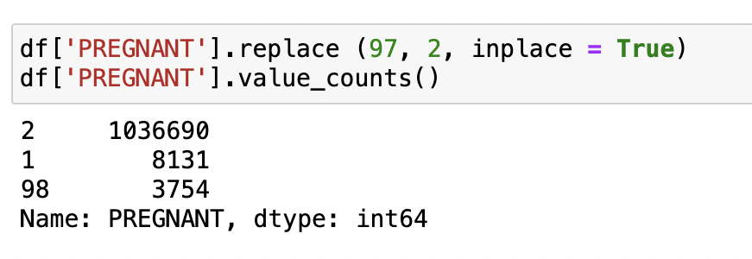
Data Preprocessing - PREGNANT
All values of 98 are of the missing values corresponding to the female values.
Replace all the corresponding values to the male section (97) with (2); since men can't be pregnant.

Slide 12
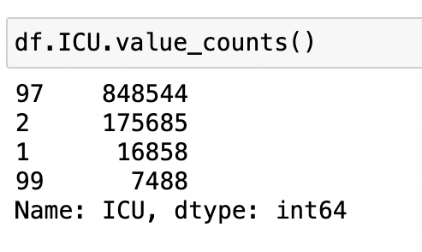
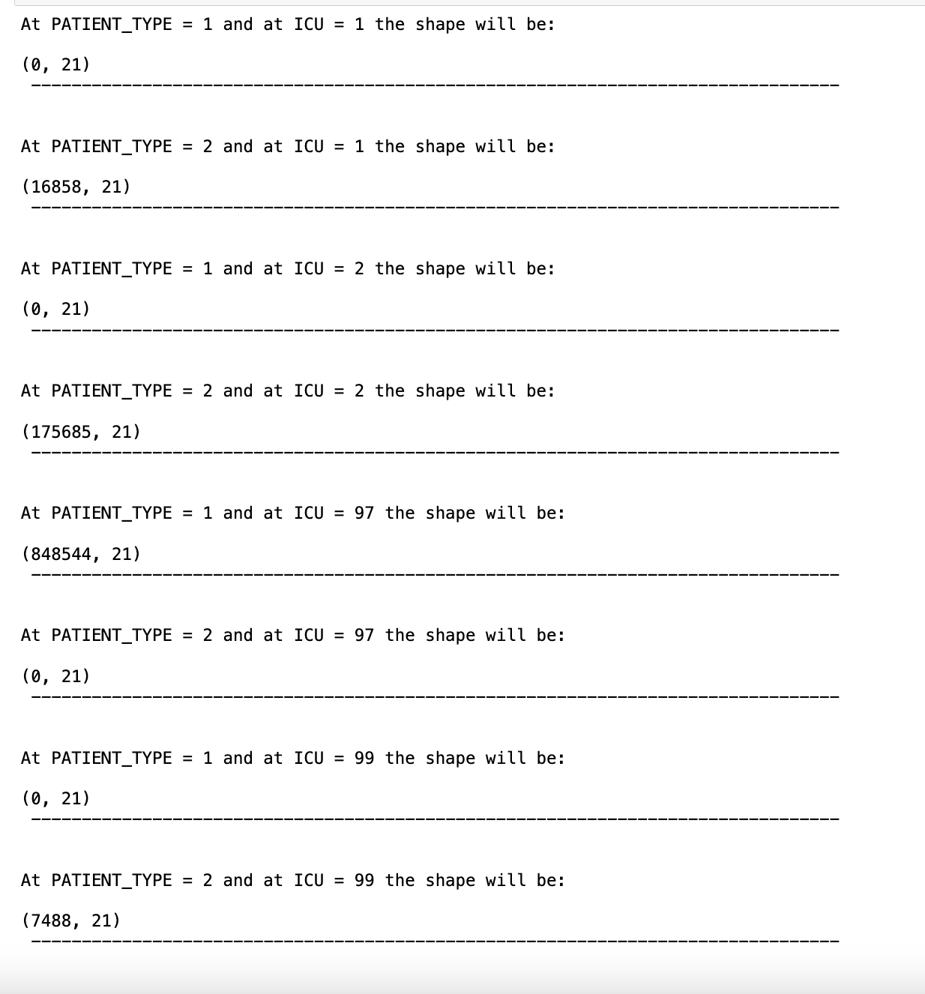
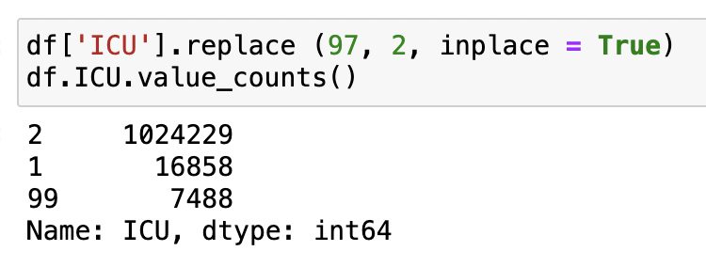
Data Preprocessing - ICU
The missing values of (97) are all corresponding to the values of PATIENT_TYPE = 1
Patients who have never been hospitalized couldn't possibly be admitted to the ICU.

Slide 13
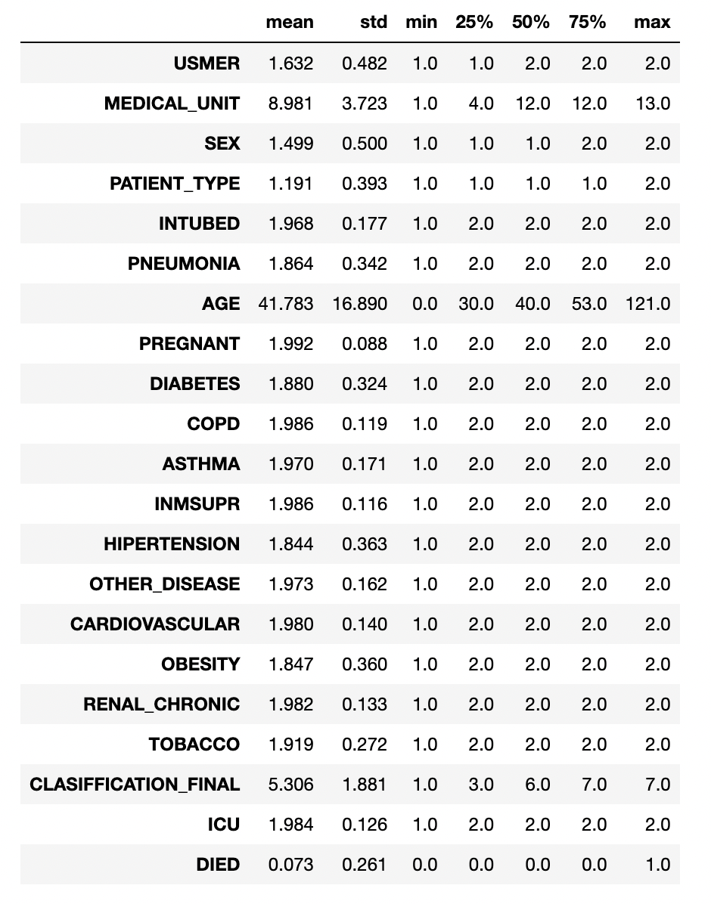
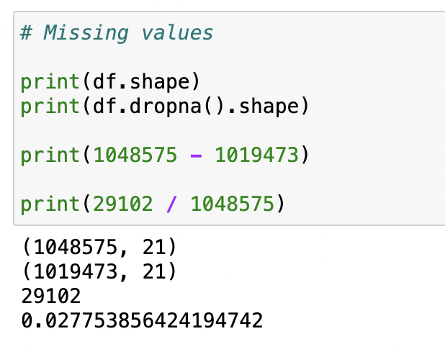
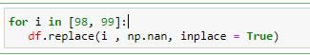
Data Preprocessing – Missing values
Rest of these missing values (values of 98 & 99) can't be predicted as they will affect our analysis.

Slide 14

Data Analysis

Slide 15
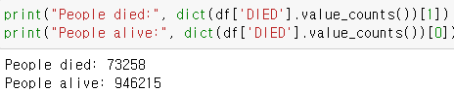
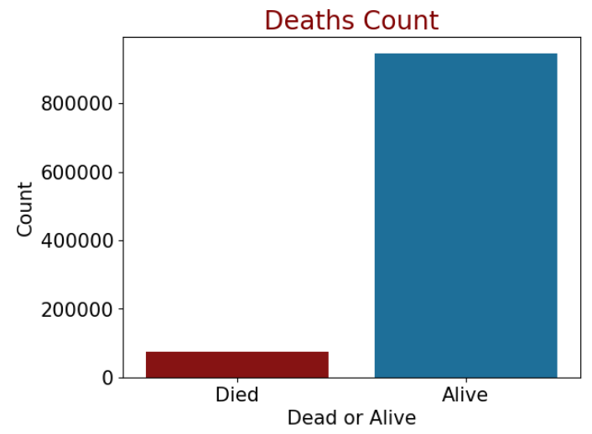
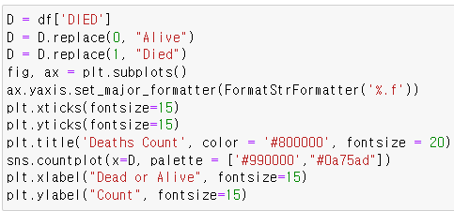
Number of people alive and died from the dataset
Data Analysis

Slide 16
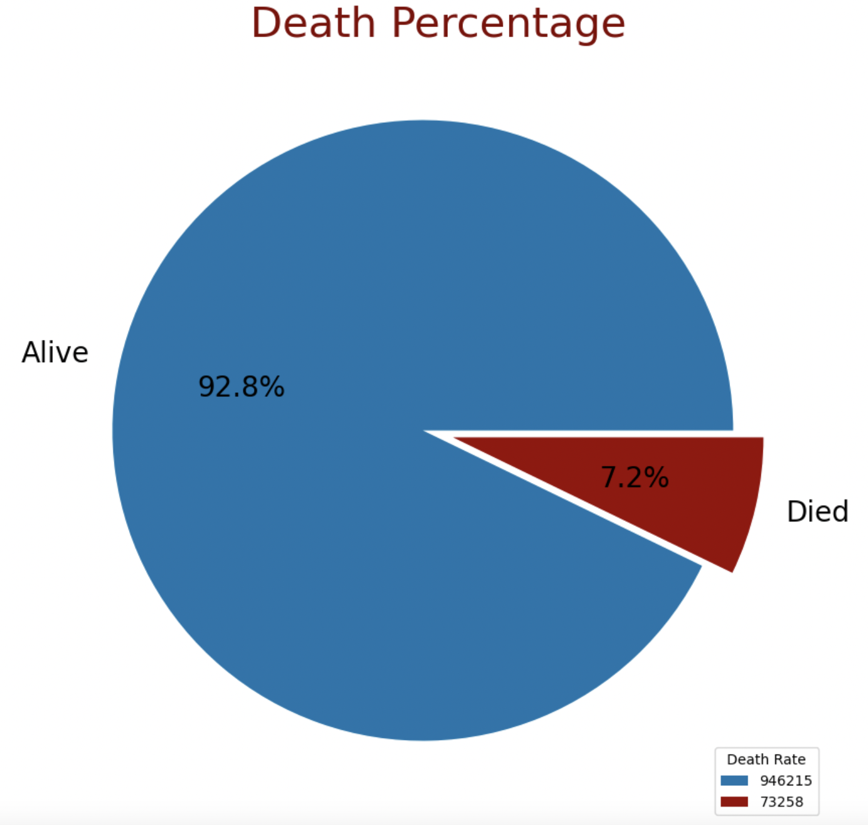
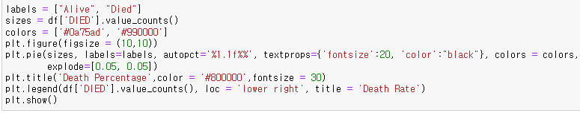
Number of people alive and died from the dataset
Data Analysis

Slide 17
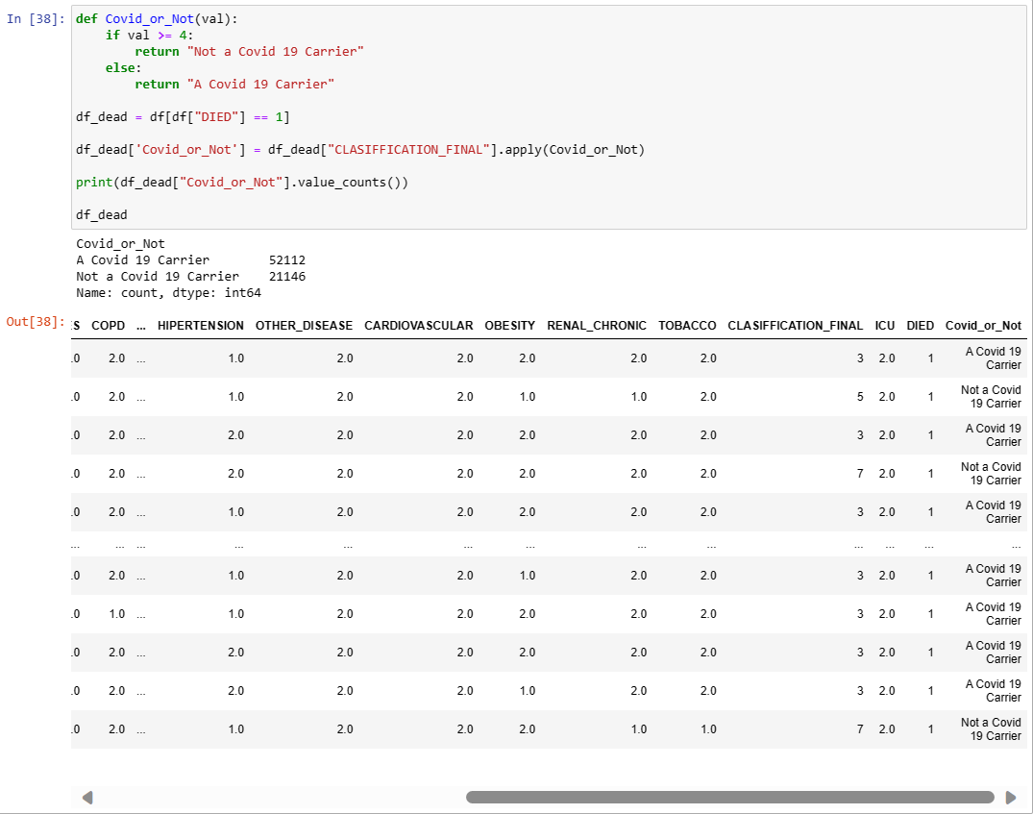
Define new column “Covid_or_Not” from on the CLASSIFICATION_FINAL
Data Analysis

Slide 18
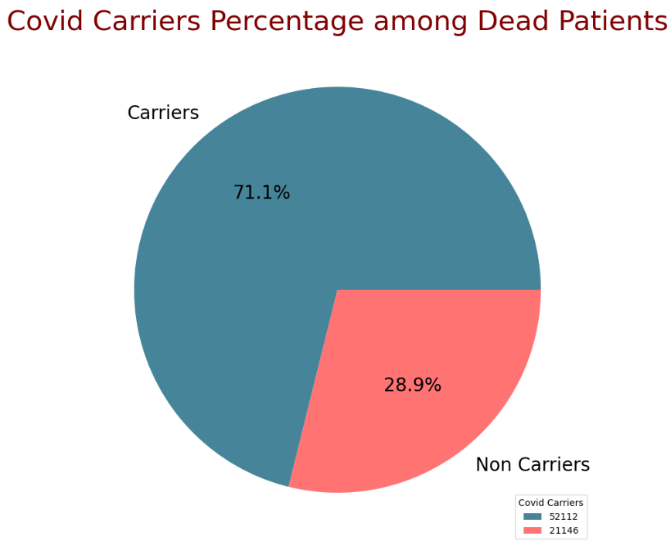
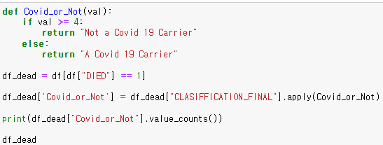
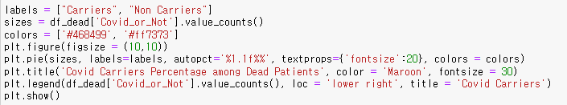
Then, calculate the proportion of Covid carrier among the dead. Among dead, 71.1 % of the patient were COVID carriers.
Data Analysis

Slide 19
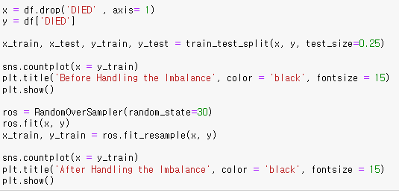
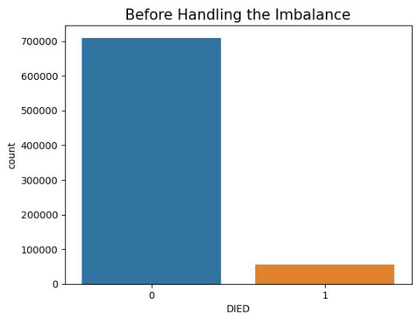
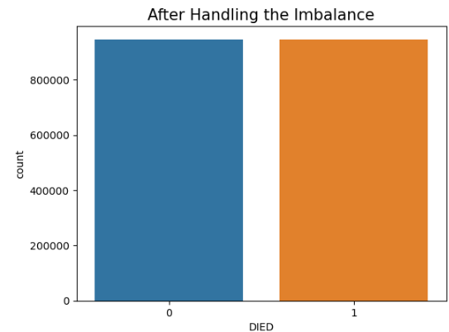
Imbalance Issues

Slide 20

Feature Selection

Slide 21
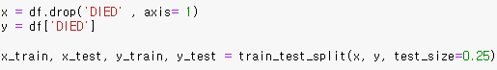
Data Splitting
75% of training, and 25% of testing.
Used hold-out evaluation since it is 1000k rows.

Slide 22
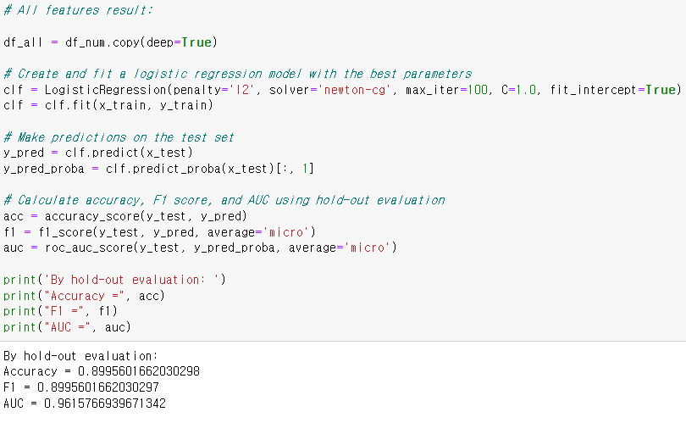
Full Model

Slide 23
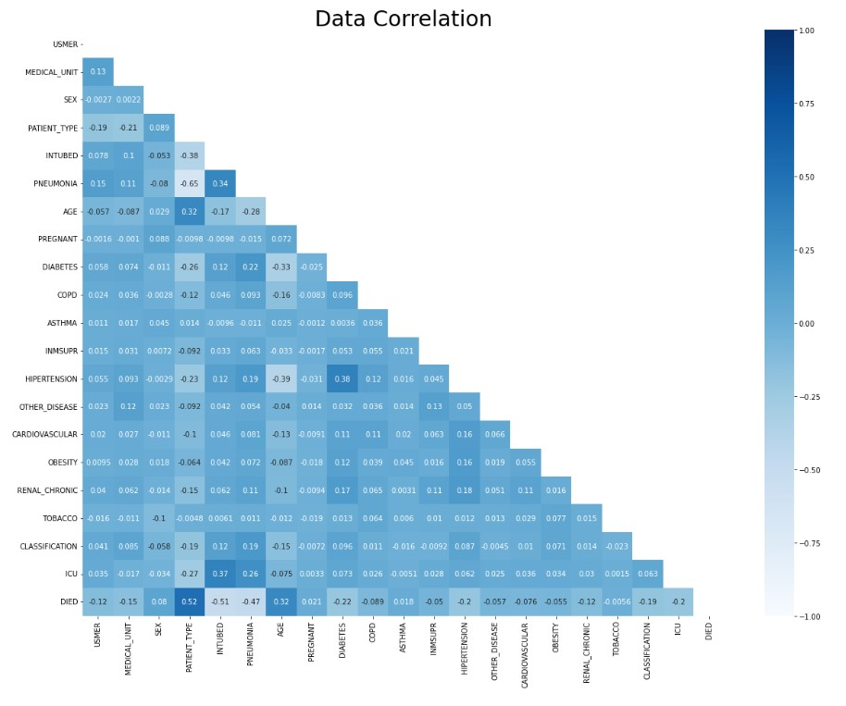
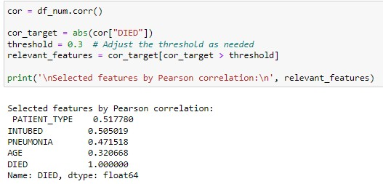
Filter Model

Slide 24
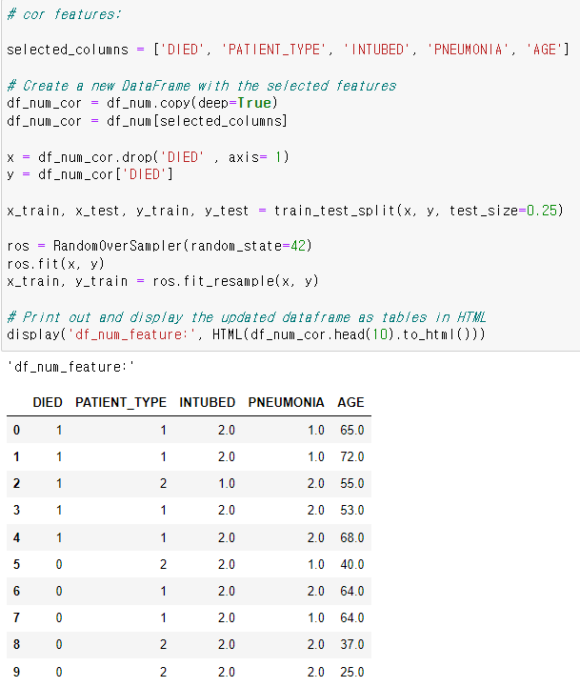
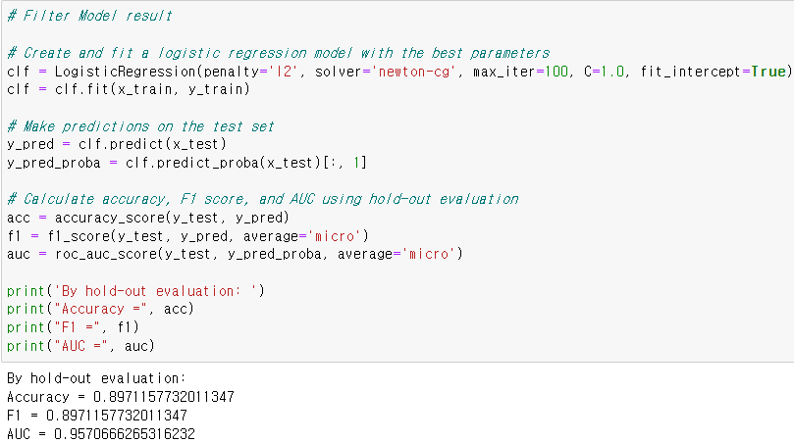
Filter Model

Slide 25
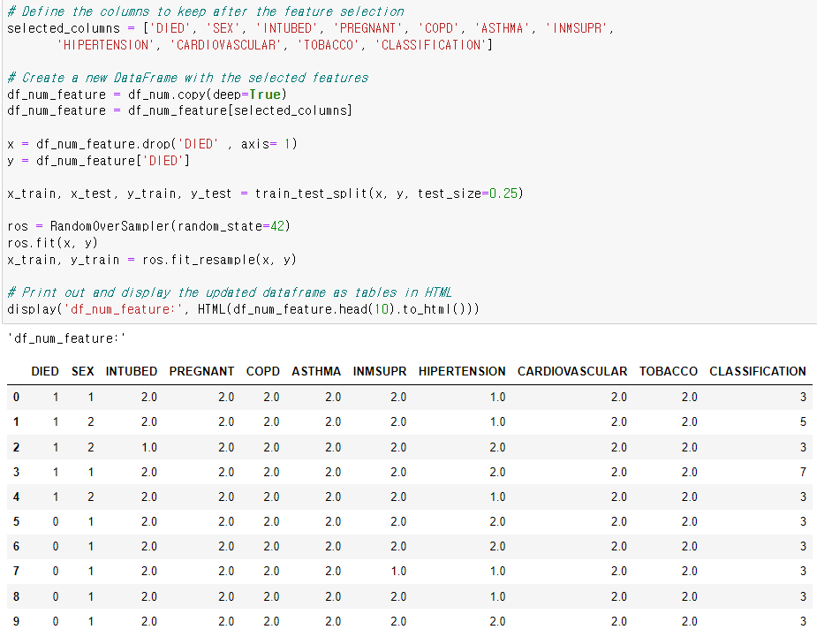
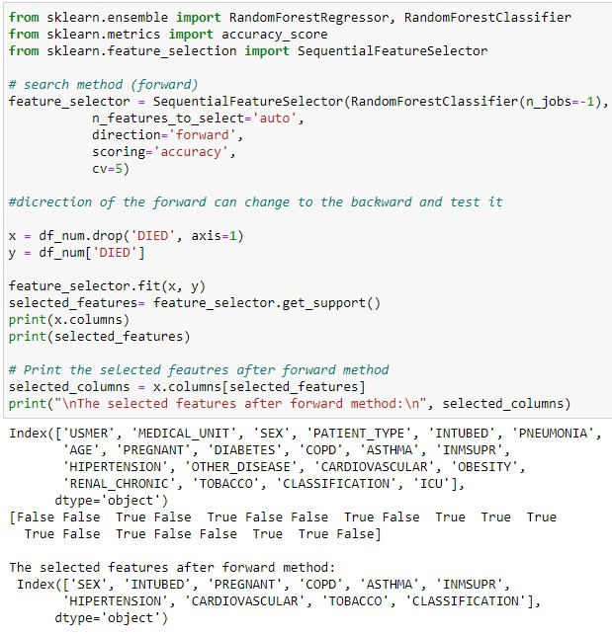
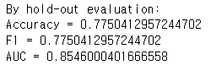
Wrapper Model

Slide 26
Best Features
Using all features is the best.
Category | Full Model | Filter Model | Wrapper Model
Accuracy | 0.8996 | 0.8971 | 0.7750
F1 | 0.8996 | 0.8971 | 0.7750
AUC | 0.9616 | 0.9571 | 0.8546

Slide 27
Modeling

Slide 28
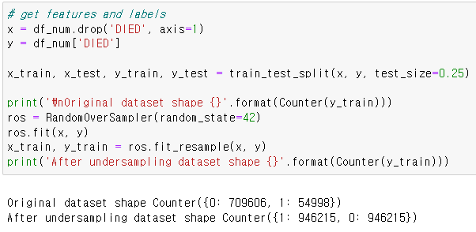
Resampling
We applied resampling for each model.

Slide 29
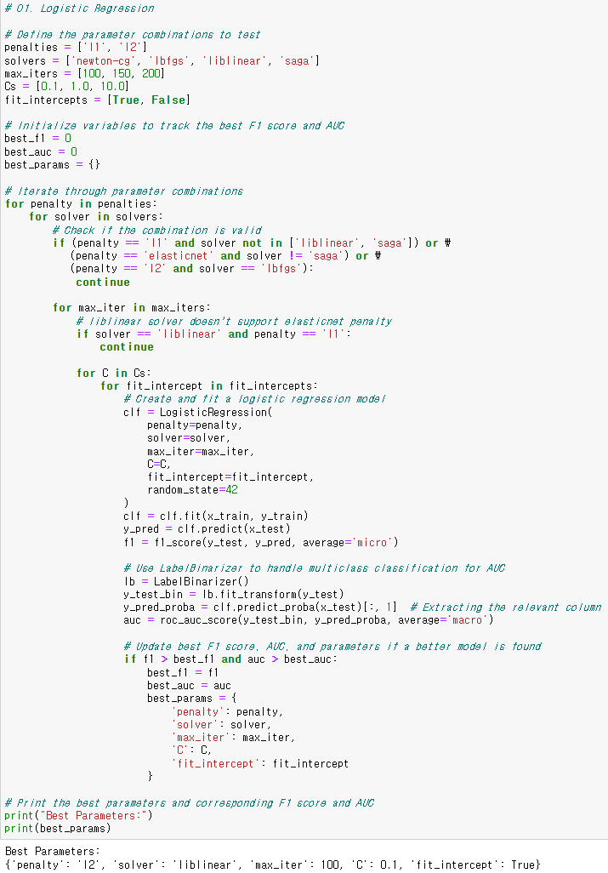
Best Parameters

Slide 30
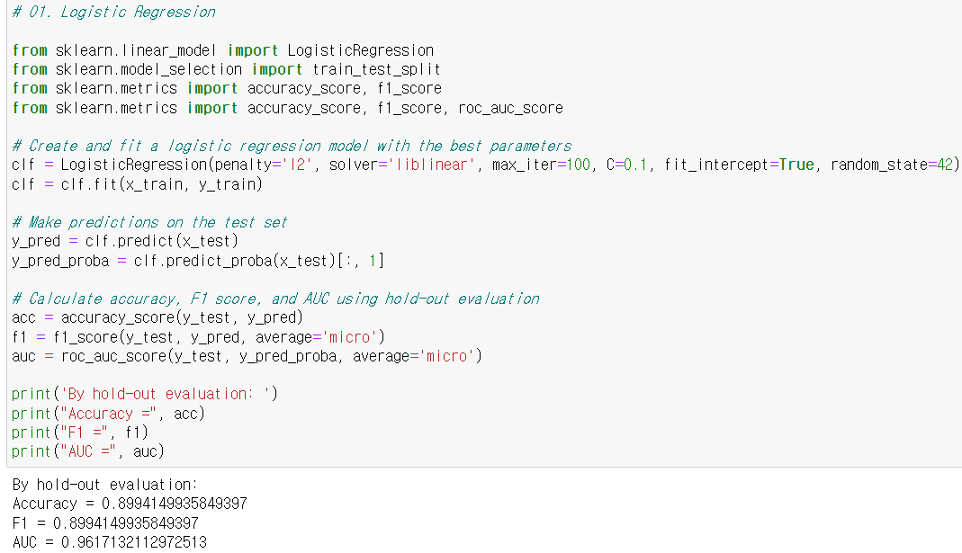
Logistic Regression

Slide 31
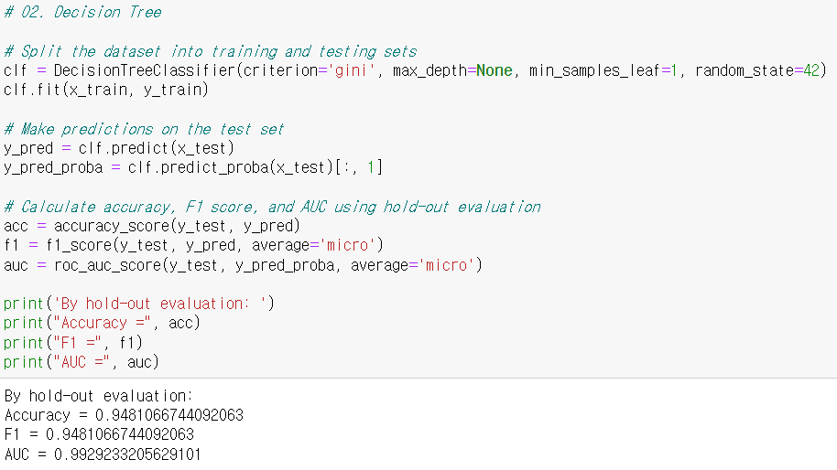
Decision Tree

Slide 32
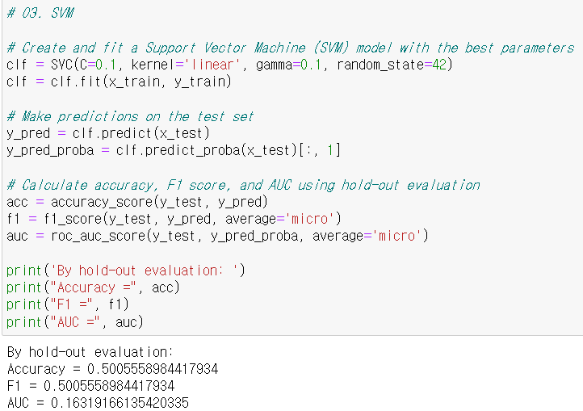
SVM

Slide 33
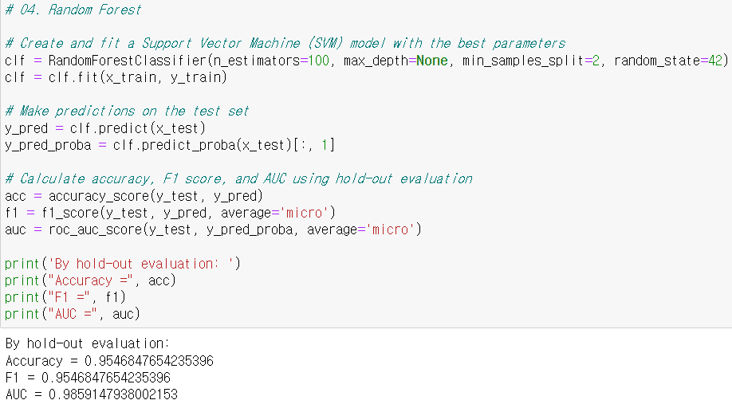
Random Forest

Slide 34
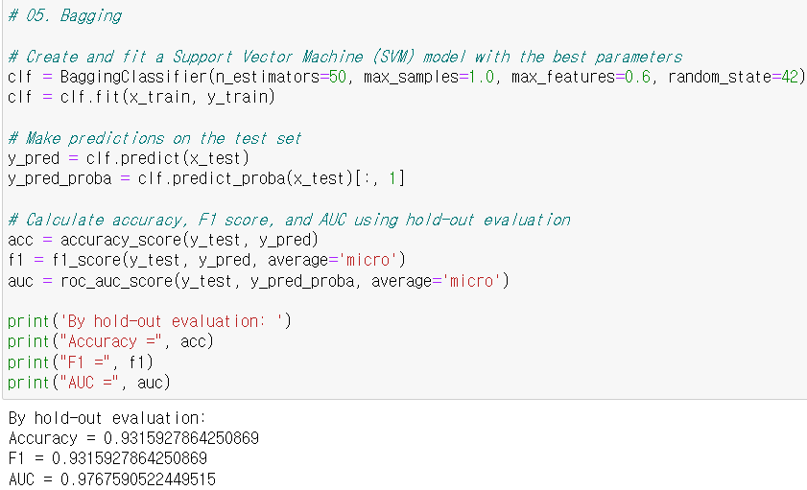
Bagging Method

Slide 35
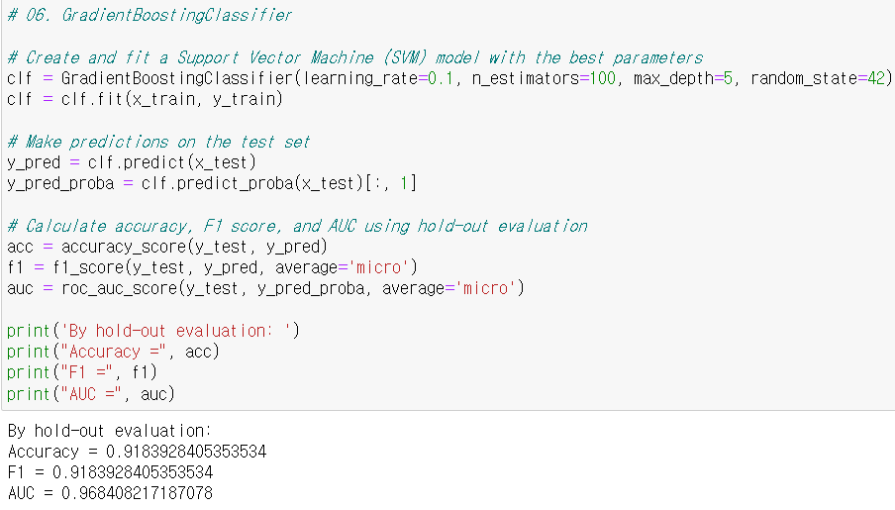
Gradient Boosting

Slide 36
Best Model
Decision Tree is the best model according to AUC.
Random Forest is the best model according to accuracy & F1.
Category | Logistic Regression | Decision Tree | SVM | Random Forest | Bagging | GradientBoosting
Accuracy | 0.8994 | 0.9481 | 0.5006 | 0.9547 | 0.9315 | 0.9183
F1 | 0.8994 | 0.9481 | 0.5006 | 0.9547 | 0.9315 | 0.9183
AUC | 0.9617 | 0.9929 | 0.1632 | 0.9859 | 0.9767 | 0.9684

Slide 37
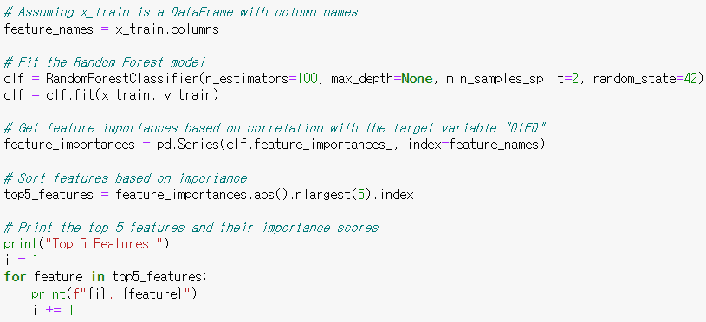
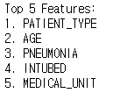
Top Features

Slide 38

Conclusion

Slide 39
Conclusion
The best models are:
Random Forest: Accuracy of 95.47%
Decision Tree: AUC of 99.29%
Top features for prediction:
Patient Type = Hospitalized
INTUBED = Connected to the ventilator
PNEUMONIA = Have air sacs inflammation
AGE = Old
One challenge:
Required massive computational power.

Slide 40

Thank You

